Slide 1
Update 3
Dev Bhatia
Ultrafast Optics Laboratory
Boston University

Slide 2
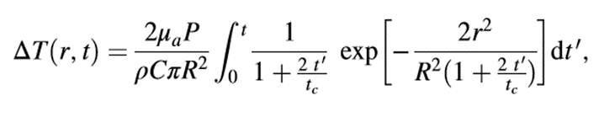


Equation
Taken from:
Li, Xinyu, Jia Liu, Shanshan Liang, and Changsen Sun. "980-nm Infrared Laser Modulation of Sodium Channel Kinetics in a Neuron Cell Linearly Mediated by Photothermal Effect." Journal of Biomedical Optics 19, no. 10 (2014): 105002-105002.
μa = 73.9 cm^-1 Optical Absorption Coefficient
R = 93.41 μm Beam waist at axial distance
z = 164.56 μm Axial Distance
tc = .01523 s Characteristic time of the thermal lens
P = variable wattage irradiation laser power, obeys Beer-Lambert law with the initial laser power Po
κ = 0.6 W/mK thermal conductivity
ρ = 1000 kg/m^3 density of water
c = 4188 J kg^-1 K^-1 heat capacity
r = 25 μm radius of the fiber core

Slide 3
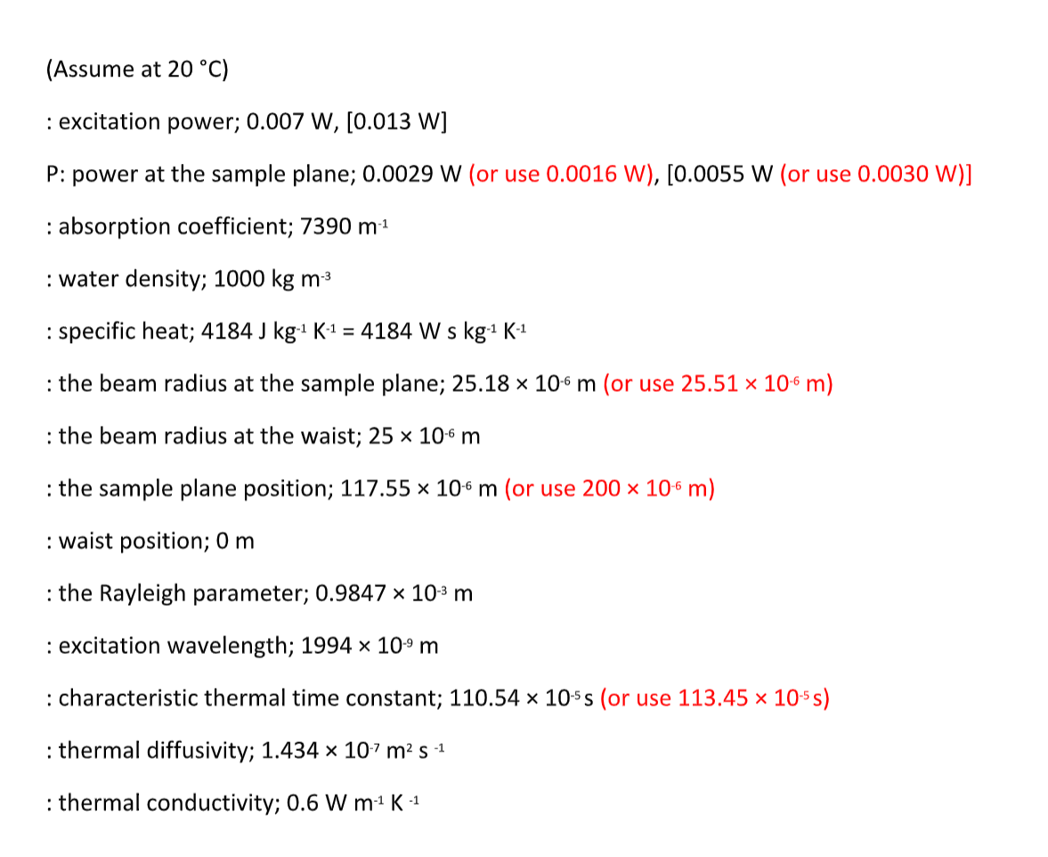
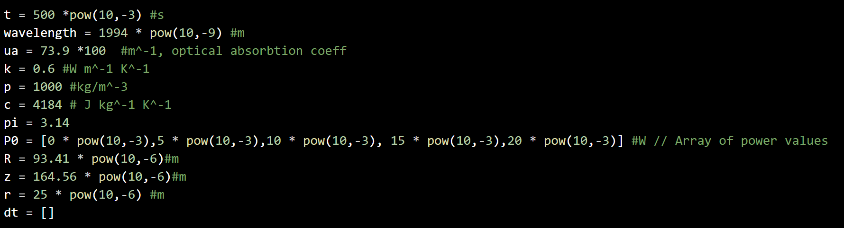
Variable Implementation

Slide 4
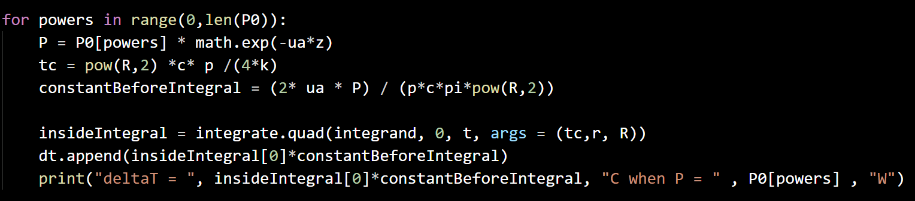
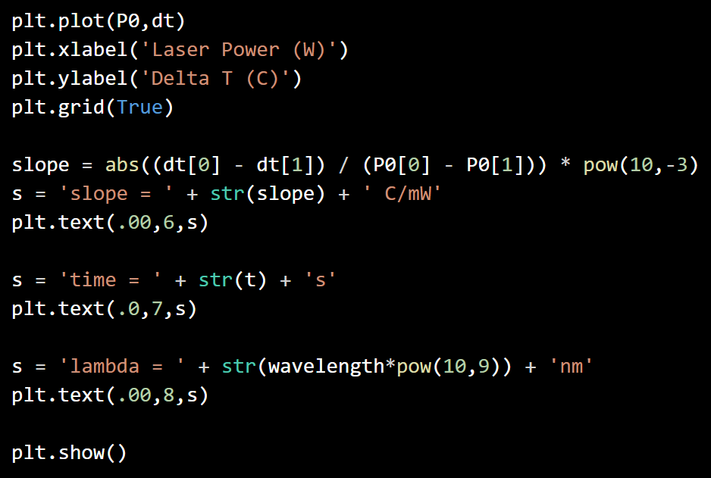
Integration & Plotting

Slide 5
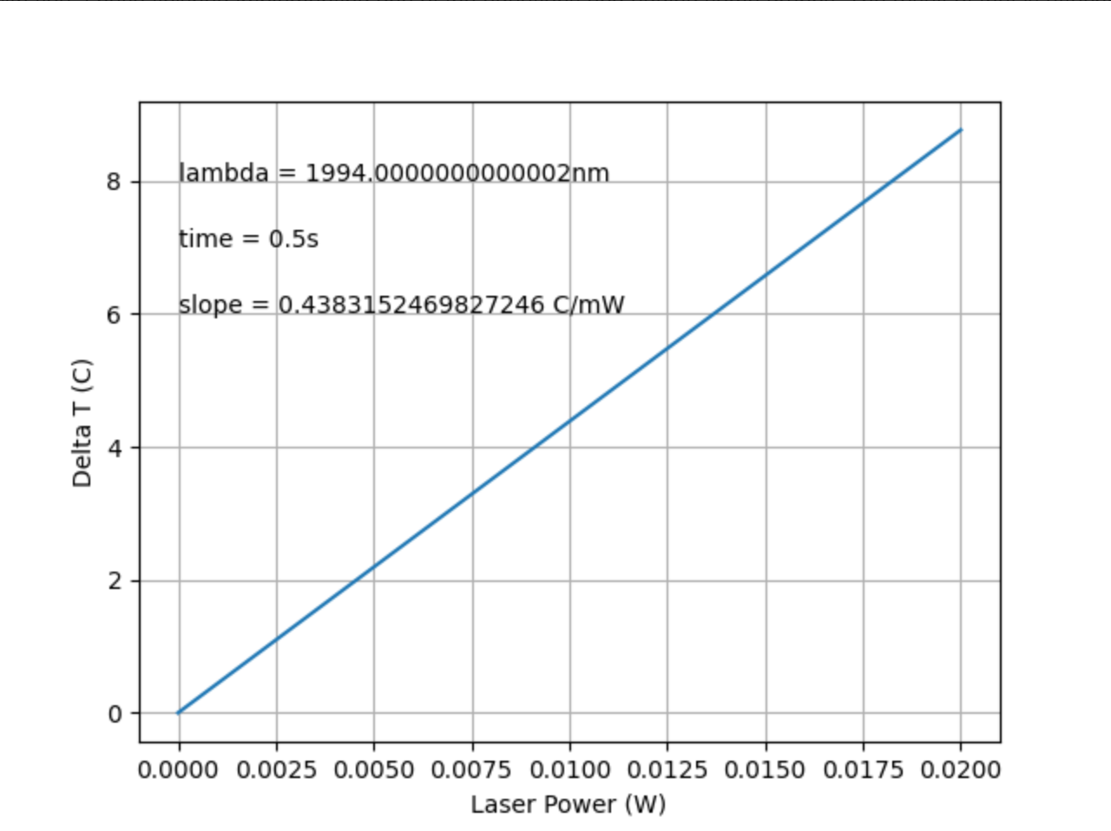
Results

Slide 6

Alternate Considerations
The following equation was considered, but ultimately dismissed as it does not account for the water absorption effect
Taken From:
Yao, Jing, Beiying Liu, and Feng Qin. "Rapid Temperature Jump by Infrared Diode Laser Irradiation for Patch-Clamp Studies." Biophysical Journal 96, no. 9 (2009): 3611-619

Slide 7
Next Steps
Continue to dive into Vanderbilt codebase
Integrate written simulation into Jia Fu’s Neuron Simulation

